Slide 1

SRM INSTITUTE OF SCIENCE AND TECHNOLOGY SCHOOL OF COMPUTING
DEPARTMENT OF COMPUTER SCIENCE AND ENGINEERING
18CSP107L / 18CSP108L - MINOR PROJECT / INTERNSHIP
<cyberbullying detection>
Batch ID:4P_MP446
RA2111003030446
KARAN RANA
RA2111003030439
SUHAIL SAIFI
RA2111003030435
MOHD.ZUFAR HASAN ALVI
RA2111003030436
SOHAIL
Guide name: Mr. MAYANK GUPTA
Designation:Assistant Professor
Department: department of computer science

Slide 2
Abstract
This project develops a machine learning-based system to detect cyberbullying in Hinglish text on social media. Using algorithms like SVM, Naive Bayes, and Logistic Regression, the system classifies content as bullying or non-bullying. It processes informal language and slang, providing a tool to identify harmful content in real-time and promote safer online spaces.

Slide 3
Introduction
With social media’s widespread use, cyberbullying has become a serious concern, impacting mental health and online safety. This project focuses on detecting cyberbullying specifically in Hinglish—an informal mix of Hindi and English commonly used in India. Leveraging machine learning models like SVM and Naive Bayes, our system is designed to accurately classify Hinglish text as bullying or non-bullying, addressing the unique challenges of slang and code-switching

Slide 4
Existing system
There are many systems working in this domain:
Perspective API by Jigsaw (Google)
Perspective API, developed by Jigsaw (Google), uses machine learning to assign toxicity scores to online comments, helping platforms moderate abusive language.
2. ReThink App
a mobile app by Trisha Prabhu, helps prevent cyberbullying by prompting users to reconsider potentially offensive messages before sending.
3. SentiStrength
a sentiment analysis tool that detects bullying and harmful language in social media by scoring the intensity of negative and aggressive content.

Slide 5
Problem statement and Objectives 1. Cyberbullying in Hinglish on social media is challenging to detect due to informal language, slang, code-switching, and the limitations of existing systems in handling multilingual or hybrid text. 2. objective is to develop a machine learning system that accurately detects and classifies cyberbullying in Hinglish text for safer online interactions.

Slide 6
Proposed system
Our project provides real-time detection of cyberbullying in Hinglish text on social media platforms using machine learning algorithms, ensuring immediate identification of harmful content.
It provides efficient text preprocessing, utilizing tokenization, stemming, and stop word removal to effectively handle informal language and slang in Hinglish.
It gives a multi-model approach, combining SVM, Naive Bayes, and Logistic Regression to improve the accuracy of detecting harmful content.

Slide 7
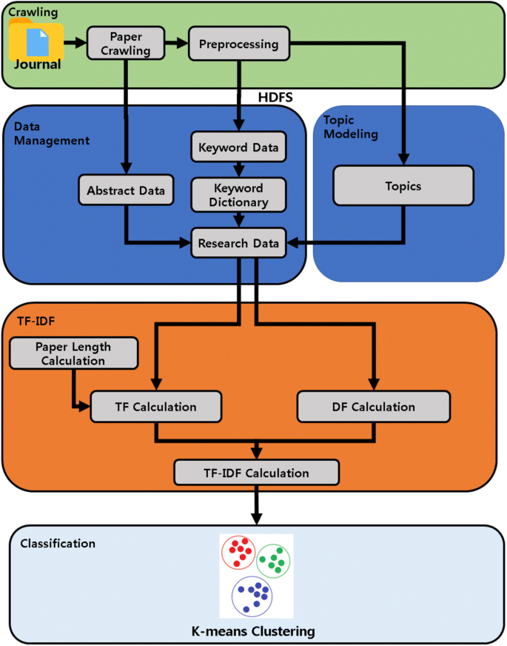
Architecture/Block Diagram of the proposed model

Slide 8
Modules Description Data Collection Module: Gathers Hinglish text data from social media platforms to build a dataset for training and testing the model. Text Preprocessing Module: Cleans and prepares text by performing tokenization, stemming, and stop word removal to handle the complexities of Hinglish. Model Training and Prediction Module: Trains machine learning models (SVM, Naive Bayes, Logistic Regression) and uses them to classify text as bullying or non-bullying in real time.

Slide 9

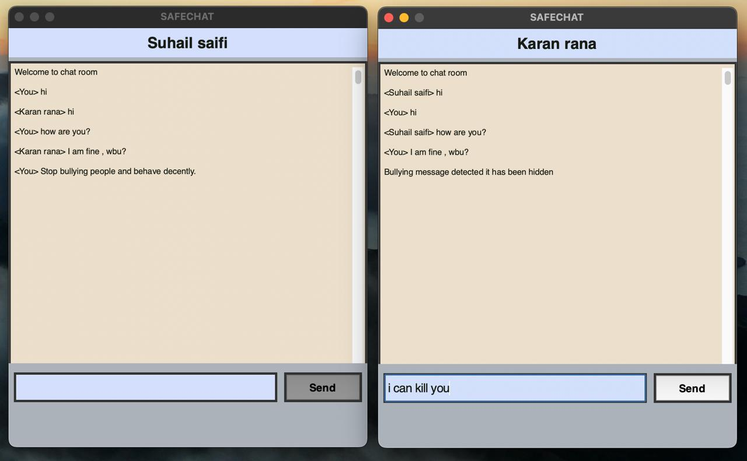
Intermediate Results and Discussion These are the pictures showcasing UI design and server showcase in working phase. User Login page chatroom of both user talking with each other

Slide 10
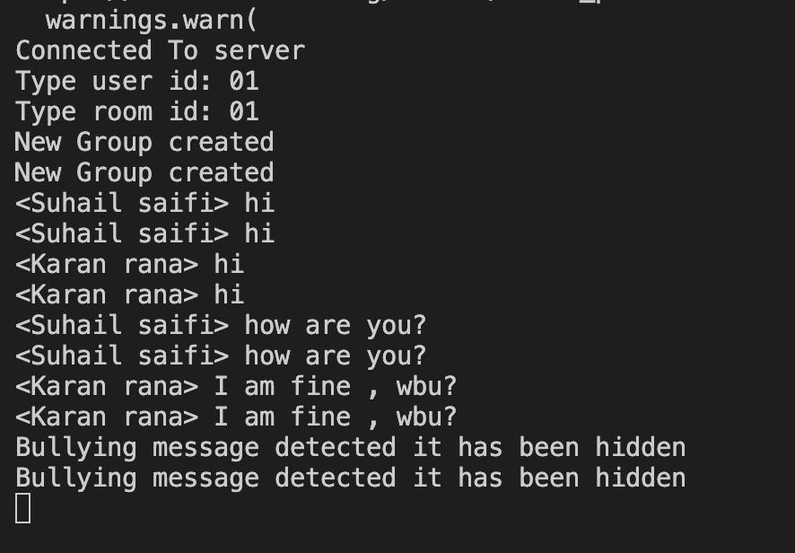
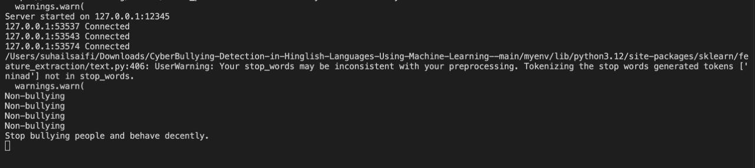
Server side working stage and detection of hate messages

Slide 11
References B. Dean, “How many people use social media in 2021? (65+ statistics),” Sep. 2021. [Online]. Available: https://backlinko.com/social-media-users J. W. Patchin, “Summary of our cyberbullying research (2004-2016),” Jul. 2019. [Online]. Available:https://cyberbullying.org/summary-of-our-cyberbullying-research S. M. Novianto, I. Isa, and L. Ashianti, “Cyberbullying classification using text mining,” in Proc. 1st Int. Conf. on Informatics and Computational Sciences (ICICoS), 2017, pp. 241–246. C. Van Hee et al., “Automatic detection of cyberbullying in social media text,” PLoS One, vol. 13, no. 10, p. e0203794, 2018. M. A. Al-Garadi et al., “Predicting cyberbullying on social media in the big data era using machine learning algorithms: Review of literature and open challenges,” IEEE Access, vol. 7, pp. 70 701–70 718, 2019.

Slide 12
Questions?

